Slide 1
App Review Rating Prediction System – Project Overview
Understanding user feedback through advanced prediction methods

Slide 2
Introduction and Project Overview

Slide 3

App Review Rating Prediction System
Project Overview and Goal
The system predicts numeric app review ratings from free-text reviews while providing insights for non-technical stakeholders.
Software Engineering Approach
Emphasis on robust architecture, traceability, and iterative improvement in system design over standalone modeling.
Phased Project Development
Sequential phases from understanding needs, designing system, to building and evaluating machine learning models.
Outcome and Insights
Focus on design rationale, experimental learning, and system-level outcomes explaining model performance and choices.

Slide 4

Project Goals and Motivation
Predicting App Review Ratings
The project aimed to create a machine learning system predicting ratings from unstructured app reviews.
Balancing Performance and Interpretability
An iterative approach was used to balance technical accuracy with interpretability, scalability, and maintainability.
System-Oriented Design Approach
Focus was on system-wide interactions including preprocessing, multiple models, and documented risks.

Slide 5
Phase 1 – Problem Understanding and Requirements

Slide 6

Stakeholders, Personas, and Requirements
Stakeholder Personas
Identified key personas include end users, technical staff, and management, each with distinct needs and interests.
Functional Requirements
Requirements include data ingestion, text preprocessing, prediction generation, and interpretable result presentation.
Non-Functional Requirements
Emphasis on usability, interpretability, performance for batch processing, and system maintainability over time.
Dataset Challenges
Dataset revealed class imbalance, noisy text, and prevalence of short reviews, influencing design decisions.

Slide 7
Phase 2 – Architecture and Planning

Slide 8
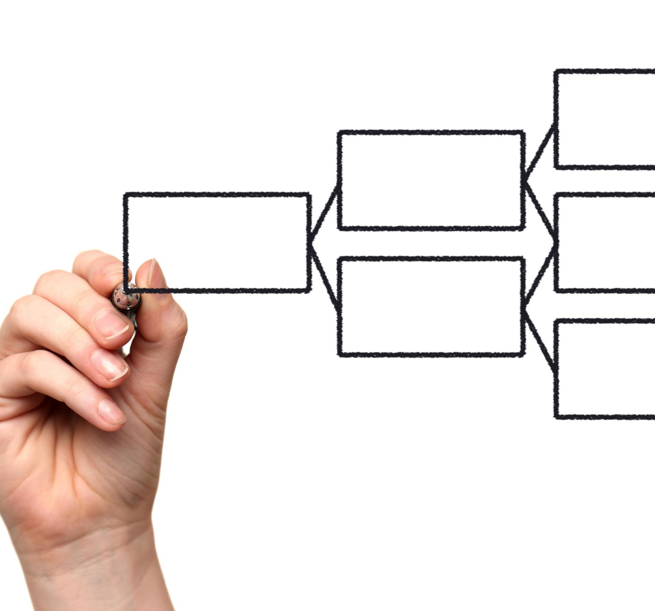
System Architecture and Planning Artifacts
System Context Diagram
Defines system boundaries and shows interactions with external users, data sources, and ML services.
Component Diagram
Decomposes system into key responsibilities like data ingestion, preprocessing, ML pipeline, and visualization.
Success Criteria and Risk Management
Includes a success criteria matrix for traceability and a formal risk register for technical and organizational risks.
Iteration and Experimentation Plan
Guides disciplined, reproducible experimentation aligned with stakeholder needs through phased iterations.

Slide 9
Phase 3 – Modeling and Experimentation

Slide 10

Baseline and Pipeline-Based Models
Baseline Model Performance
The baseline linear regression model showed poor results on noisy, imbalanced text with negative R-squared and high errors.
Pipeline-Based Ensemble Models
Decision forest and boosted trees introduced non-linear and ensemble methods, yielding modest improvements over baseline.
Impact of Feature Engineering
Introducing unigram n-gram text feature extraction significantly improved model performance beyond algorithm choice.
Importance of Preprocessing
Preprocessing and feature engineering are crucial for improving model outcomes on complex, noisy text data.

Slide 11

AutoML Models and Advanced Feature Engineering
AutoML Model Evaluation
Phase 3 evaluated AutoML models XGBoost and LightGBM for regression tasks using advanced pipelines.
Advanced Feature Engineering
Automated pipelines included TF-IDF features, numeric imputation, categorical encoding, and feature scaling.
LightGBM Advantages
LightGBM excelled due to handling sparse data and its leaf-wise tree growth strategy for better generalization.
Architectural Pipeline Abstraction
Maintaining pipeline abstraction allowed flexibility to evaluate different model implementations without redesign.

Slide 12
Challenges, Learnings, and Comparative Outcomes

Slide 13
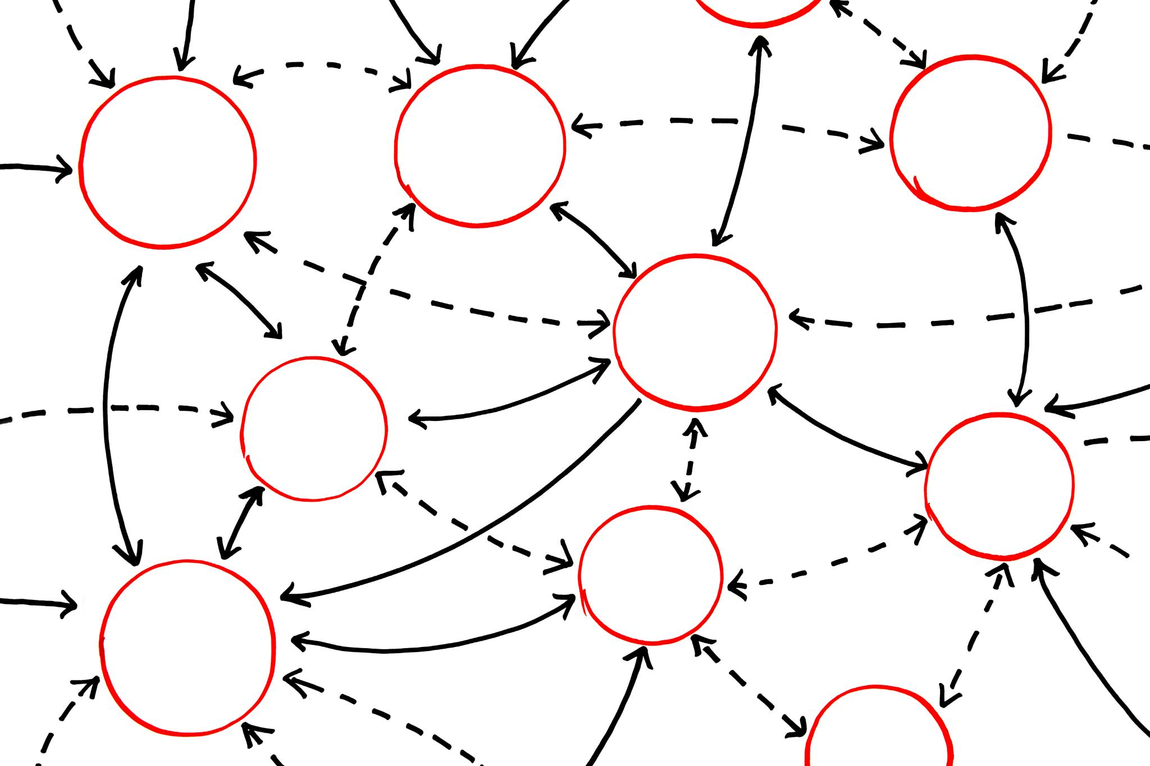
Key Challenges and Iterative Learning
Pipeline Stability Challenges
Small changes in preprocessing often caused cascading effects impacting pipeline stability in Azure ML Designer.
Memory Issues with N-grams
Introducing n-gram features caused out-of-memory errors, requiring iterative constraint adjustments and log analysis.
Minimal Gains from Some Experiments
Some successful experiments, like stopword removal or algorithm changes, yielded minimal performance improvements.
Tooling Limitations Impact
Tooling constraints required proxies and clear documentation to address dynamic filtering limitations in production.

Slide 14
Conclusion and Final Outcomes

Slide 15

Final Outcomes and System Readiness
Cohesive System Development
The project resulted in a cohesive, well-documented machine learning system rather than isolated experiments.
Performance Evaluation
Comparative model evaluation identified LightGBM as the top candidate for system integration.
Disciplined Engineering Practices
Success depended on controlled experimentation, data preprocessing, and clear documentation of decisions.
Future System Refinement
The system is ready for enhancements like categorization and integration of additional data sources.

